Slide 1
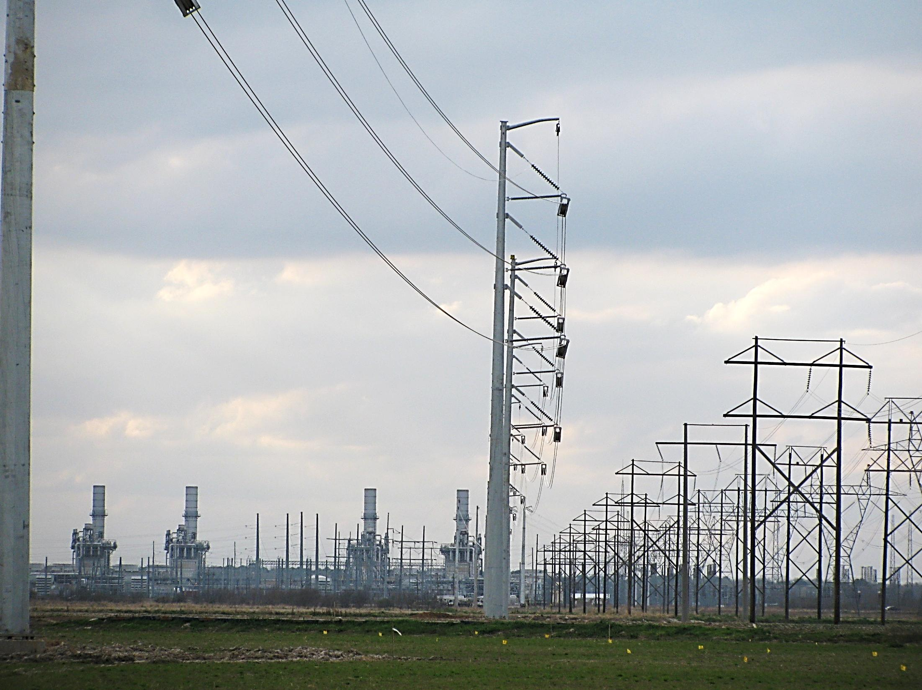

Cleco Transmission Planning Summit 2012
Coughlin Transmission Operations Center
April 26, 2012
10:00 – 11:00am

Slide 2
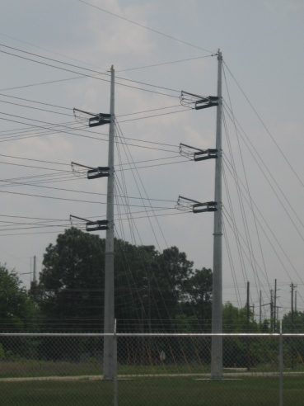
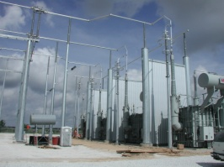
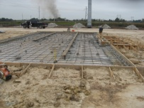
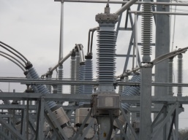
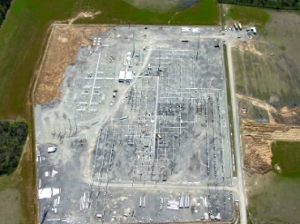
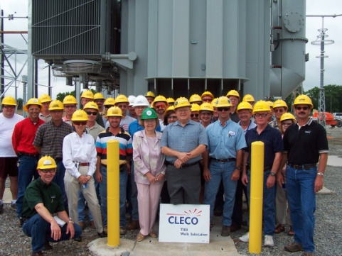
Welcome
Introduction
Terry Whitmore, Mgr- Trans Strategy & Support
James Simms, Lead Engineer- Transmission Planning
Chris Thibodeaux, Lead Engineer- Transmission Planning
Robby Michiels, Sr. Engineer- Transmission Planning
Cindy Guillot, Director Trans Policy and Contracts

Slide 3
Agenda
Introduction
Economic Planning Studies
Acadiana Load Pocket Update
2012 Transmission Construction Plan
Model Review
2012 SPP Model ACCC Results
Stakeholder Business
2012 Summer Outlook
Final Questions
Adjourn

Slide 4

Agenda
Introduction
Economic Planning Studies
Acadiana Load Pocket Update
2012 Transmission Construction Plan
Model Review
2012 SPP Model ACCC Results
Stakeholder Business
2012 Summer Outlook
Final Questions
Adjourn
Notes:
4

Slide 5
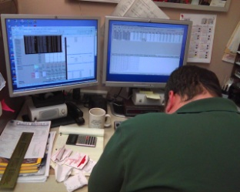
Economic Planning Studies
None were requested for 2012

Slide 6
Agenda
Introduction
Economic Planning Studies
Acadiana Load Pocket Update
2012 Transmission Construction Plan
Model Review
2012 SPP Model ACCC Results
Stakeholder Business
2012 Summer Outlook
Final Questions
Adjourn
Notes:
6

Slide 7
Acadiana Load Pocket
Update
ALP Project 2012
Acadia Affected System Upgrades
Notes:
7

Slide 8
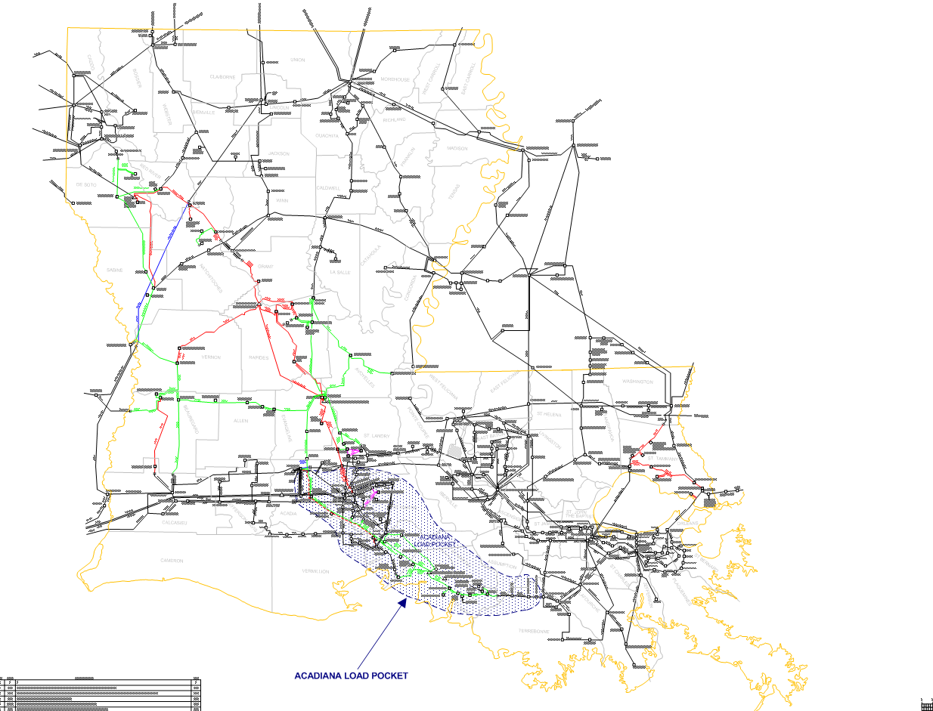
Acadiana Load Pocket
Notes:
8

Slide 9
Acadiana Load Pocket Project
Year 2012 Progress Report
Cleco Upgrades
  New 230 kV transmission line from Wells to Labbe (June 2012)
  Add a Second 500/230 kV Transformer at Wells (June 2012)
  Reconductor Segura – Hopkins 138KV transmission line (April 2012)
Entergy Upgrades
  New 230 kV transmission line from Sellers Rd to Labbe (May 2012)
Lafayette Upgrades
  New 230 kV transmission line from Labbe to Bonin (February 2012)
  2nd 230/138 kV Autotransformer at Bonin (May 2012)

Slide 10
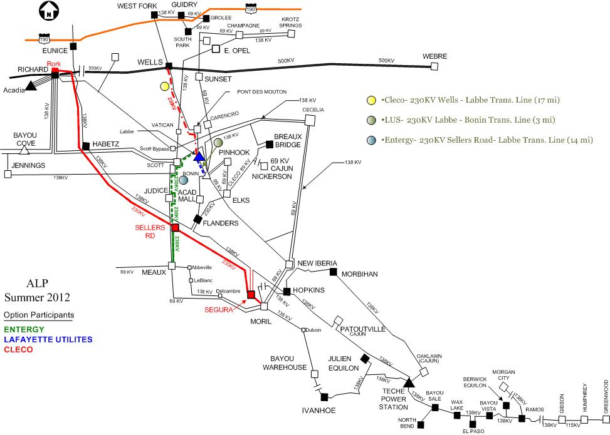
ALP Project Update – Summer 2012

Slide 11
Acadia Affected System Upgrades
Cleco Upgrades
  New 230/138 kV Autotransformer at Rork (August 2012)
  Reconductor Acadia to Richard Ckt 2 (April 2012)
  Redirect Line 1 to connect to the Rork 230/138 kV autotransformer (August 2012)
Entergy Upgrades
  Reconductor Acadia to Richard Ckt 3 and 4 (April 2012)
  Reconductor Hopkins to Moril 138 kV line (April 2012)
  Tap the existing Scanlin to Scott 138 kV line and add a new substation Bosco with a 5 ohm Reactor at Bosco
  Build a new 138 kV line from Bosco to Bloomfield (Tapped between East Opelousas and Vatican)
  Change Normally Open breakers at Richard and Scott

Slide 12
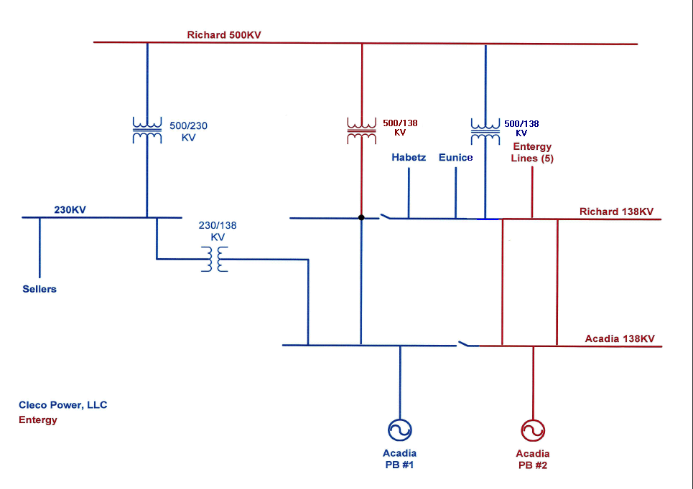
Acadia Affected System Upgrades

Slide 13
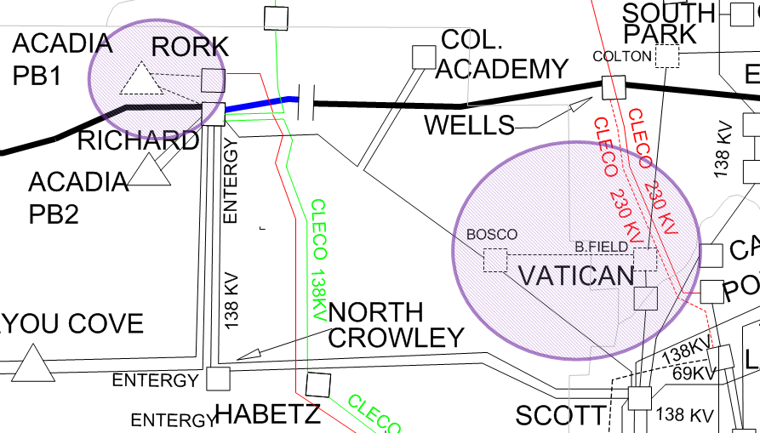
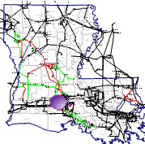
Acadia Affected System Upgrades

Slide 14
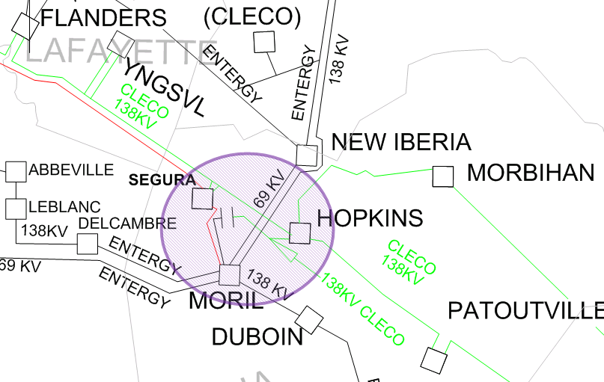
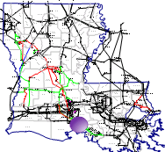
Acadia Affected System Upgrades
  - Reconductor Hopkins to Moril 138 kV line

Slide 15
Acadiana Load Pocket Update
Questions ?

Slide 16
Agenda
Introduction
Economic Planning Studies
Acadiana Load Pocket Update
2012 Transmission Construction Plan
Model Review
2012 SPP Model ACCC Results
Stakeholder Business
2012 Summer Outlook
Final Questions
Adjourn
Notes:
16

Slide 17
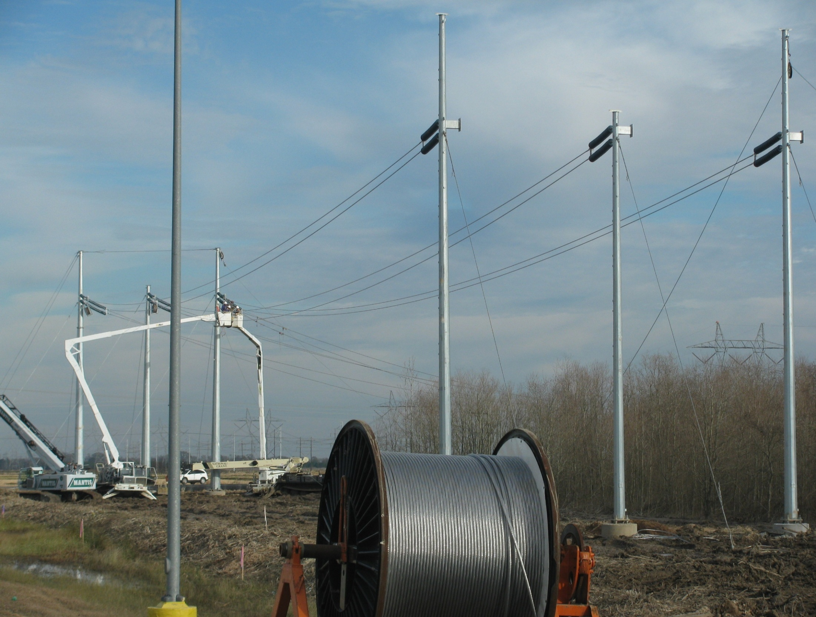
Cleco 2012 Transmission Construction Plan

Slide 18
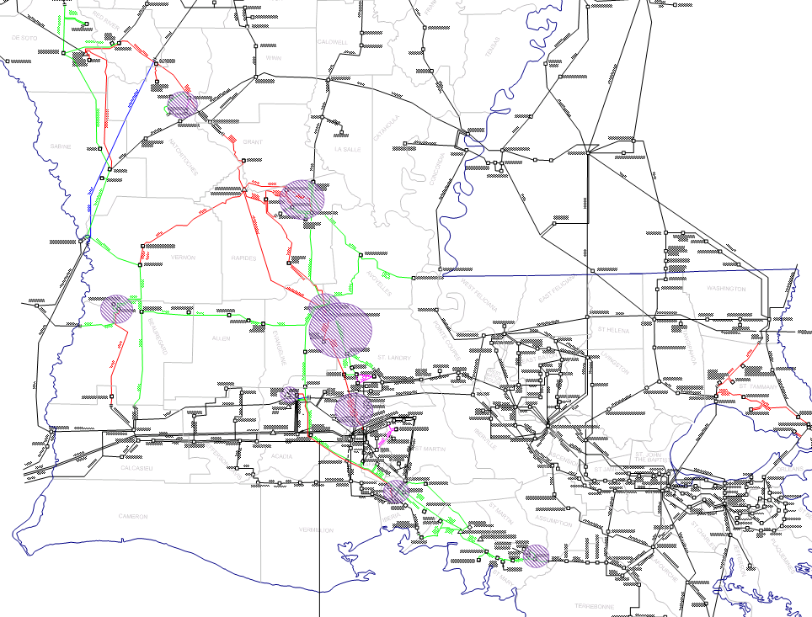
2012 Transmission Construction Plan

Slide 19
Cleco 2012 Transmission Construction Plan
Approved Projects
2012
Reconductor existing Segura – Hopkins 138KV transmission line (ALP)
Build a new 230 KV Transmission line from Wells to the LUS Labbe (ALP)
Second 500/230 KV Autotransformer at Wells Substation (ALP)
(This will complete Cleco’s participation in the ALP project.)
Transmission element replacements on Plaisance – Coughlin 138KV transmission
line 332 MVA
Second 230/138KV Autotransformer at Cocodrie Substation
Construction of a new Clarence – St. Maurice 69KV transmission line
Reconductor Acadia to Richard 138 kV line ckt 1 & 2 (Acadia Affected System)
Convert Rork to a 230 kV Ring bus with a new 230/138 kV Autotransformer (Acadia
Affected System)
Replace Ramos Capacitor Banks (Banks moved to Plaisance during Summer 2011)

Slide 20
Cleco 2012 Transmission Construction Plan
Budgeted Projects
2013
Cooper Capacitor Banks
Transmission element replacements on Plaisance – Coughlin 138KV transmission line 360 MVA
2014
New Shady Oaks 230/138 kV Autotransformer & New Sherwood to Shady Oaks 230 kV line

Slide 21
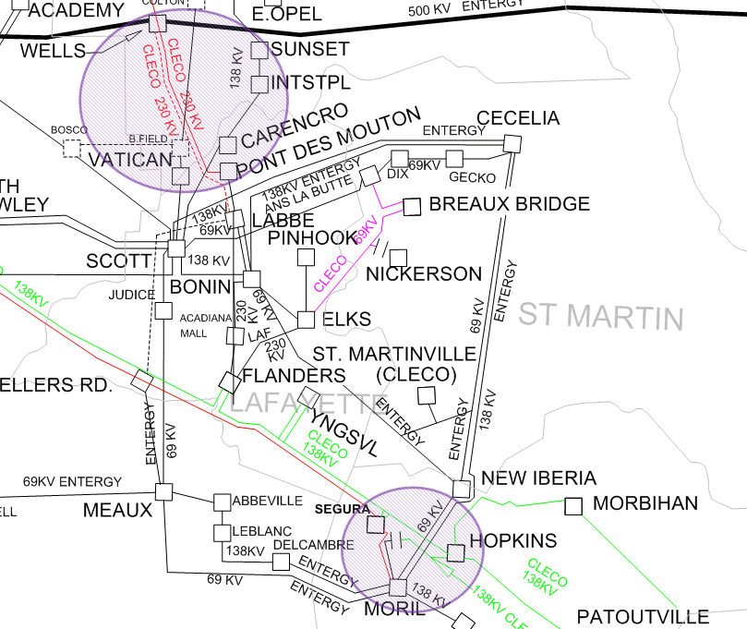
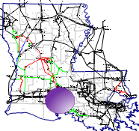
2012 Transmission Construction Plan
Cleco ALP Project Upgrades

Slide 22
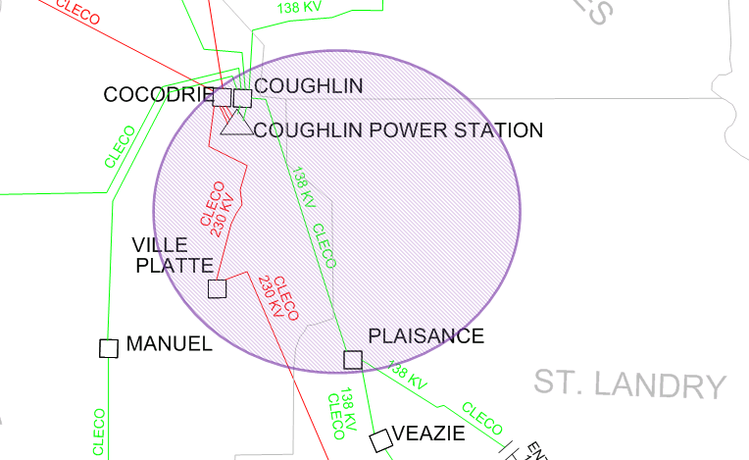
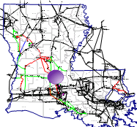
2012 Transmission Construction Plan
Coughlin – Plaisance 138 kV line Rating upgrade

Slide 23
2012 Transmission Construction Plan
Project: Transmission element replacements on Plaisance – Coughlin 138KV transmission line (Switches at Coughlin and Wave Trap at Plaisance)
In-service Date: Fall 2012
Transmission Project Justification:
  This project increases the Plaisance to Coughlin 138 kV line rating to prevent overloads FTLO Cocodrie to Ville Platte 230 kV line.
  Increase the rating to 332 MVA

Slide 24
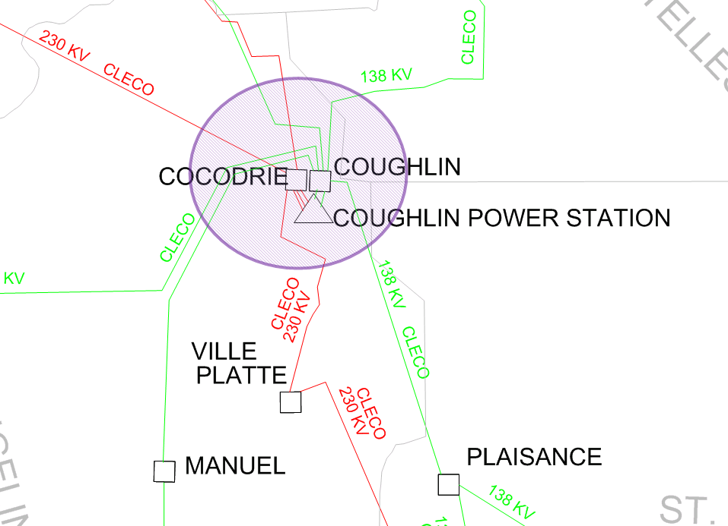
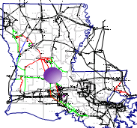
2012 Transmission Construction Plan
2nd Cocodrie 230/138 kV Autotransformer

Slide 25
2012 Transmission Construction Plan
Project: Second 230/138KV Autotransformer at Cocodrie Substation
In-service Date: October 2012
Transmission Project Justification:
  This project relieves the potential overload on the existing Cocodrie Autotransformer FTLO Cocodrie to Ville Platte 230 kV line. This project also eliminates the contingency of the existing Auto-transformer causing overloads on Coughlin to Shady Oaks 138 kV line.

Slide 26
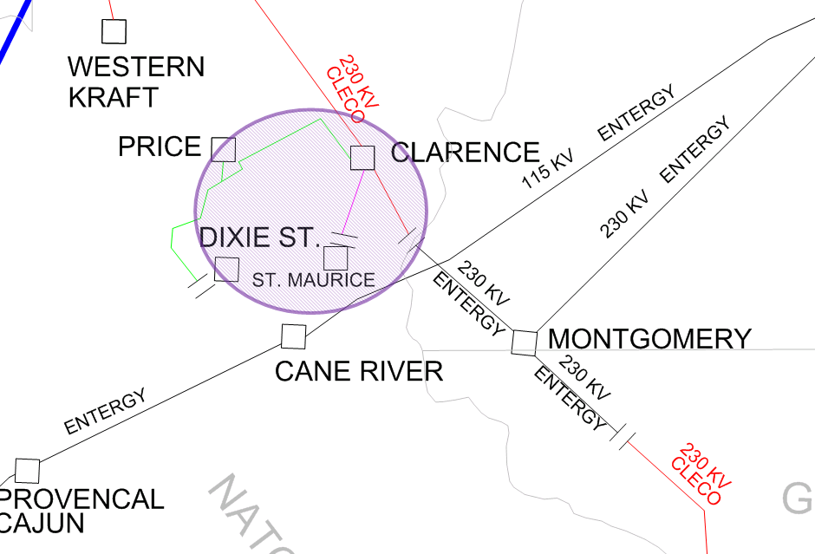
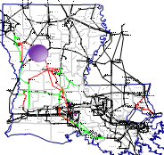
2012 Transmission Construction Plan
Clarence – St. Maurice 69 kV line

Slide 27
2012 Transmission Construction Plan
Project: Construction of a new Clarence – St. Maurice 69KV transmission line
In-service Date: June 2012
Transmission Project Justification:
  Prevents extended outages for the loss of the Clarence 230/138KV Autotransformer.
  This project provides an alternate feed for the City of Natchitoches and Price substation which allows for maintenance to the existing 138 kV line with out customer outages.

Slide 28
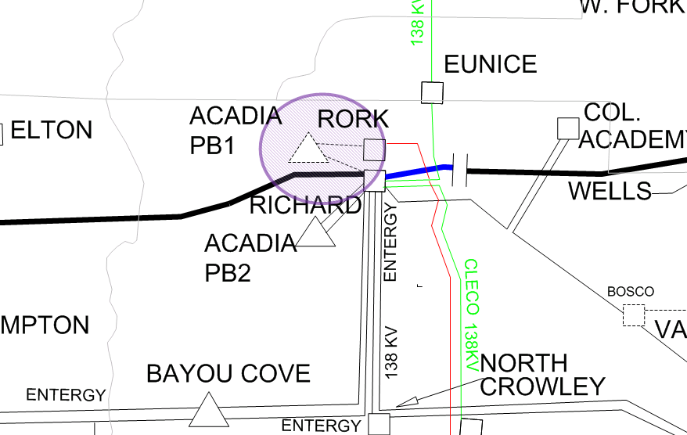
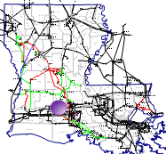
2012 Transmission Construction Plan
Cleco Rork and Acadia Upgrades (Acadia Affected System)

Slide 29
2012 Transmission Construction Plan
Project: Convert Rork to a 230 kV Ring bus with a new 230/138 kV Autotransformer (Acadia Affected System) Reconductor Acadia to Richard 138 kV line ckt 1 & 2 (Acadia Affected System)
In-service Date: August or Fall 2012
Transmission Project Justification:
  This project increases the impedance between Cleco’s Acadia power plant and Entergy’s 138 kV lines which forces more power to flow on the new 230 kV Rork to Sellers Road line. As a result this reduces flow on the 138 kV lines out of Richard and prevents overloads in the ALP.

Slide 30
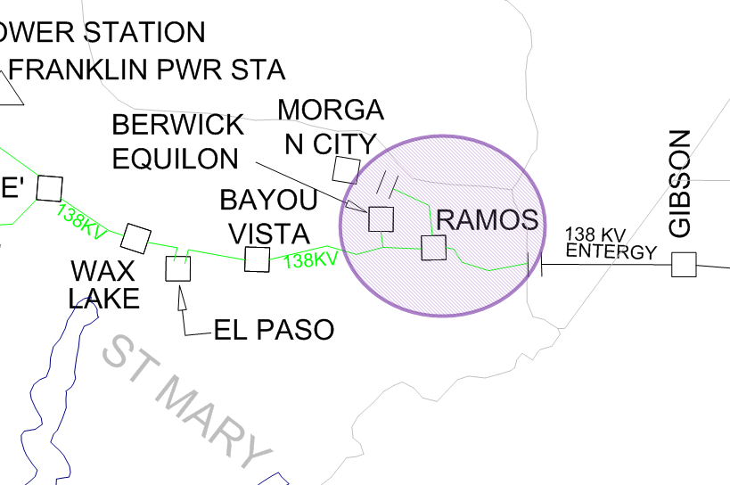
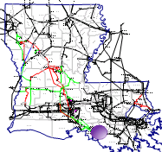
2012 Transmission Construction Plan
Ramos Capacitor Banks

Slide 31
2012 Transmission Construction Plan
Project: Replace Ramos Capacitor Banks 33.6 MVAR (Banks moved to Plaisance during Summer 2011)
In-service Date: October 2012
Transmission Project Justification:
  This project replaces the Ramos capacitor banks as part of the ALP project that were moved during the Summer of 2011 to Plaisance to support voltage. See 502 Switcharoo

Slide 32
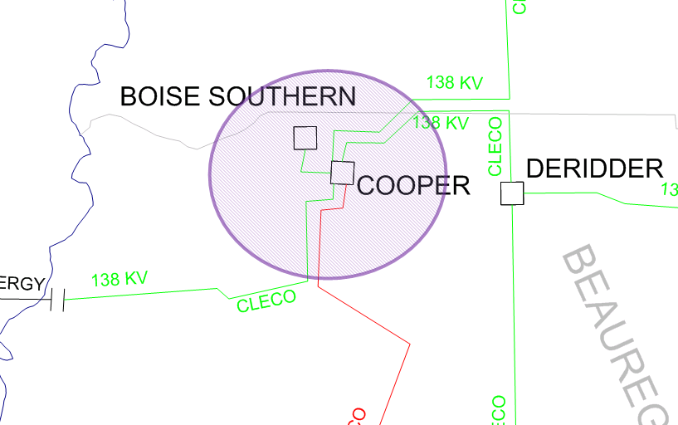
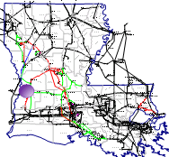
2012 Transmission Construction Plan
Cooper Capacitor Banks

Slide 33
2012 Transmission Construction Plan
Project: Cooper capacitor bank addition
In-service Date: March 2013
Transmission Project Justification:
  This project was approved to allow for maintenance on the Cooper to Leesville and Cooper to Derrider double circuit 138 kV lines and improve the voltage in the Leesville/ Derrider areas. Operationally there is no way to get an outage on these lines with out risking low voltage for the loss of the Cooper to Penton 230 kV line.

Slide 34
2012 Transmission Construction Plan
Coughlin to Plaisance 138 kV line Rating upgrade

Slide 35
2012 Transmission Construction Plan
Project: Transmission element replacements on Plaisance – Coughlin 138KV transmission line (Replace Strung bus at Plaisance)
In-service Date: May 2013
Transmission Project Justification:
  This project increases the Plaisance to Coughlin 138 kV line rating to prevent overloads FTLO Cocodrie to Ville Platte 230 kV line.
  Increase the rating to 360 MVA

Slide 36
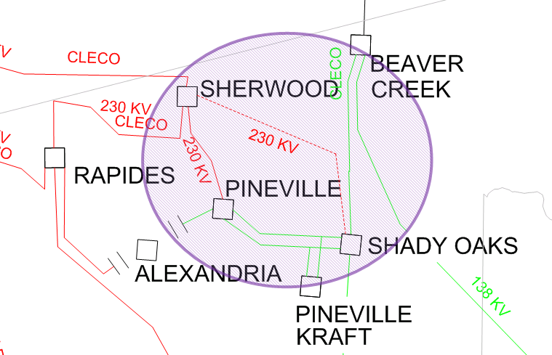
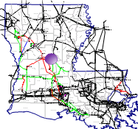
2012 Transmission Construction Plan
Sherwood to Shady Oaks 230 kV line

Slide 37
2012 Transmission Construction Plan
Project: New Shady Oaks 230/138 kV Autotransformer & New Sherwood to Shady Oaks 230 kV line
In-service Date: June 2014
Transmission Project Justification:
  This project prevents pre-contingent load shed as a result of a extended outage of either the Pineville or Twin Bridges 230/138 kV Autotransformers. Operationally with one of these transformers out of service loss of the other autotransformer would lead to low voltage in the Pineville/Alexandria areas and thermal overloads on lines in that region.

Slide 38
2012 Transmission Construction Plan
Questions ?

Slide 39
Agenda
Introduction
Economic Planning Studies
Acadiana Load Pocket Update
2012 Transmission Construction Plan
Model Review
2012 SPP Model ACCC Results
Stakeholder Business
2012 Summer Outlook
Final Questions
Adjourn
Notes:
39

Slide 40
Model Review
502 Switcharoo Project
Update line Impedance
Update Generator (Pmax, Pmin, Qmax, Qmin)
Hineston 230 kV Substation

Slide 41
Model Review
502 Switcharoo Project
May 2011 Cooper 230/138 kV Autotransformer failed which created operational problems looking at the next contingency under Summer Peak conditions.
Moved the existing 230/138 kV Autotransformer from West fork to Cooper. Prior to making this move, an evaluation of the Summer Peak model reveled low voltages under N-1 conditions in the Guidry and Plaisance substations.
Moved Ramos Capacitor banks to Plaisance since Ramos banks were not needed until 2017 for the ALP project.
Bought a used 87 MVA 230/138 kV Auto to replace the West fork Auto that was moved to Cooper.

Slide 42
Model Review
Update Line Impedance
Over the past several years Cleco has began measuring the line impedance in the field during line outages.
The calculated impedance data has been replaced on all the lines that we have measured data.
No major changes to powerflow models
Updated Generator Data
Update all generators in Cleco’s control area with measured or calculated data from field test within the past couple of years. (Pmax, Pmin, Qmax, Qmin)

Slide 43
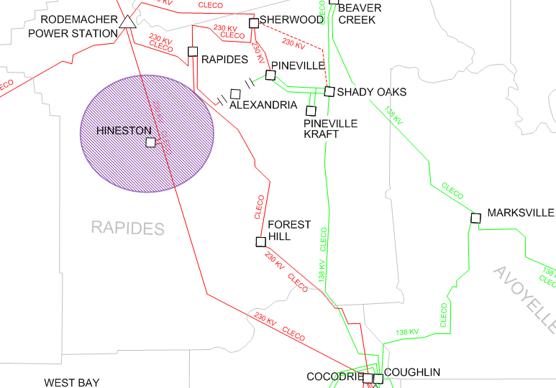
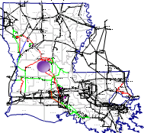
Model Review
Hineston 230 kV sub

Slide 44
Model Review
Hineston 230 kV sub
Distribution Project which will Tap the Rodemacher to Cocodrie 230 kV line near Hineston. This new substation will serve load in that area and unload some distribution circuits in that area.
This project has an in-service date of December 2012.
This will be added to the SPP models next fall.

Slide 45
Model Review
Questions ?

Slide 46
Agenda
Introduction
Economic Planning Studies
Acadiana Load Pocket Update
2012 Transmission Construction Plan
Model Review
2012 SPP Model ACCC Results
Stakeholder Business
2012 Summer Outlook
Final Questions
Adjourn
Notes:
46

Slide 47
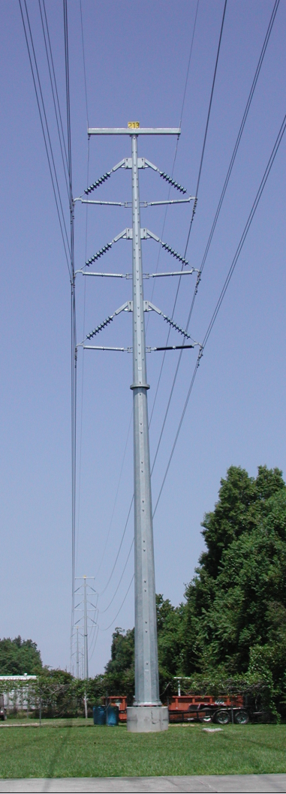
2012 SPP Model ACCC Results
SPP 2012 Models
  2012 (Spring, Summer Shoulder, Summer, Fall, Winter)
  2013(Spring, Low load, Summer Shoulder, Summer, Fall, Winter)
  2014 (Spring, Summer, Winter)
  2018 (Low load, Summer, Winter)
  2023 (Summer, Winter)

Slide 48
2012 SPP Model ACCC Results
International Paper to Mansfield 138kV transmission line thermal overload
Powerflow models: 2012, 2013, and 2018 summer peak models
Contingency: Dolet Hills to S.W.Shreveport 345 kV transmission tie line
Resolution: The Dolet Hills Operating Guide addresses this outage and resulting overload. The AEP-W portion of the output and related transfer of power from the Dolet Hills Plant to AEP-W would be reduced to a level such that the flow on the IP to Mansfield 138 kV transmission line is within limits.

Slide 49
2012 SPP Model ACCC Results
International Paper to Wallace Lake 138kV transmission tie line thermal overload
Powerflow models: 2012, 2013, 2018 summer peak and 2012, 2013 Summer Shoulder models
Contingency: Dolet Hills to S.W.Shreveport 345 kV transmission tie line
Resolution: The Dolet Hills Operating Guide addresses this outage and resulting overload. The AEP-W portion of the output and related transfer of power from the Dolet Hills Plant to AEP-W would be reduced to a level such that the flow on the IP to Mansfield 138 kV transmission line is within limits.

Slide 50
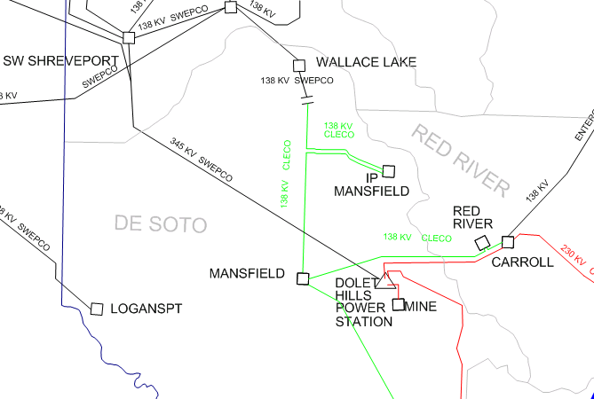
2012 SPP Model ACCC Results
IP Mansfield to Wallace Lake 138 kV line 117%
Mansfield to IP Mansfield 138 kV line 111%
Contingent Element:
Dolet Hills to S.W. Shreveport 345 kV line
Mitigation: Implement the Dolet Hills operating guide

Slide 51
2012 SPP Model ACCC Results
Gibson to Ramos 138 kV transmission line thermal overload
Powerflow models: 2018 summer peak model
Contingency: Webre to Wells 500 kV transmission line
Resolution: The Webre to Wells Operating Guide addresses this outage and resulting overload.

Slide 52
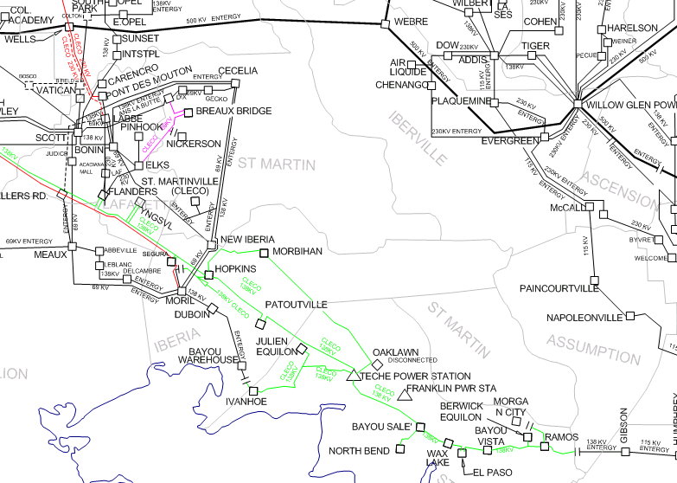
2012 SPP Model ACCC Results
Contingent Element:
Webre to Wells 500 kV line
Gibson to Ramos 138 kV line 106%
Mitigation: Implement the Webre – Wells Operating guide

Slide 53
2012 SPP Model ACCC Results
Many 138 kV bus low voltage
Powerflow models: 2014, 2018, and 2023 summer peak models
Contingency: Fisher to Many 138 kV transmission line
Resolution: This violation can be mitigated by installation of a 28.8 MVAr capacitor bank at the Many 138 kV substation. This issue has been evaluated in the past but seems to come and go from year to year. Further evaluation is necessary to determine if the 28.8 MVAr capacitor bank will be added to the Construction Base Plan.

Slide 54
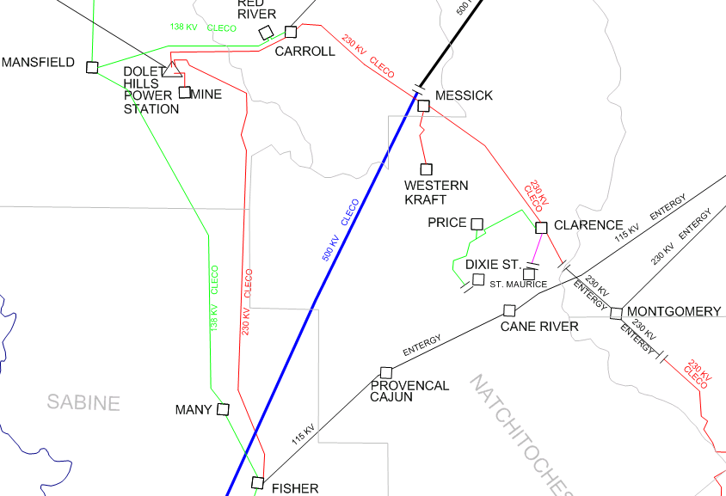
2012 SPP Model ACCC Results
Many Low voltage 0.8550 pu
Contingent Element:
Fisher to Many 138 kV line
Mitigation: Potentially add 28.8 MVAr Capacitor Bank to Construction Plan

Slide 55
2012 SPP Model ACCC Results
Questions ?

Slide 56
Agenda
Introduction
Economic Planning Studies
Acadiana Load Pocket Project Update
2012 Transmission Construction Plan
Model Review
2012 SPP Model ACCC Results
Stakeholder Business
2012 Summer Outlook
Final Questions
Adjourn
Notes:
56

Slide 57
Stakeholder Business
Chance for Stakeholders to bring issues up for discussion

Slide 58
Stakeholder Business
NERC WebRegistry
OATI has been tasked to develop a system to replace TSIN.com.
The new system is designed and maintained by OATI.
The new system uses the specifications as outlined by NAESB for standard product names.
All companies on eTag must register within webRegistry. TSIN will no longer be used, and all non-updated data will go away. All source(s) and sink(s) need to be registered for eTag.
URL for webRegistry:
https://www.naesbwry.oati.com/NAESBWRY/sys-index.wml
URL for instructions on how to register:
http://www.naesb.org/pdf4/weq_eir_webregistry_pse_quick_start_guide.pdf
First time webRegistry is published into ETag – May 14, 2012.

Slide 59
Agenda
Introduction
Economic Planning Studies
Acadiana Load Pocket Project Update
2012 Transmission Construction Plan
Model Review
2012 SPP Model ACCC Results
Stakeholder Business
2012 Summer Outlook
Final Questions
Adjourn
Notes:
59

Slide 60
2012 Summer Outlook
Contingencies within the ALP should not result in thermal overloads once the ALP project is completed.
Lower Natural Gas prices have created a West to East bias on the Wells to Webre 500 kV line. The Transmission System has typically been planned and constructed for an East to West flow or a low West to East bias on this 500 kV line.
Original ALP project was planned with 900 MW flowing from Webre to Wells. This year we have seen flow as high as 1000 MW flowing in the opposite direction.
As a result we see potential operational issues not addressed in the long term power flow models this summer.

Slide 61
Wells to Webre 500kV flow (Red 2010 Blue 2011)

Slide 62
Wells to Webre 500kV flow (Red 2011 Blue 2012)

Slide 63
2012 Summer Outlook
Potential new flowgates for this summer:
  Scott to Semere FTLO Richard to Wells 500 kV line
  Teche to Bayou Sale FTLO Wells to Webre 500 kV line
  Champagne to Bobcat FTLO Wells to Webre 500 kV line
  Coughlin to Plaisance FTLO Cocodrie to Ville Platte 230 kV line
  Cocodrie Auto FTLO Cocodrie to Ville Platte 230 kV line
  Plaisance to Champagne FTLO Cocodrie to Ville Platte 230 kV line

Slide 64
2012 Summer Outlook
Questions ?

Slide 65
Agenda
Introduction
Economic Planning Studies
Acadiana Load Pocket Project Update
2012 Transmission Construction Plan
Model Review
2012 SPP Model ACCC Results
Stakeholder Business
2012 Summer Outlook
Final Questions
Adjourn
Notes:
65

Slide 66
Final Questions?

Slide 67
2012 Cleco Transmission Planning Summit
Oasis
  http://www.oatioasis.com/clec/index.html
Trueshare
  http://www.trueshare.com/
Contact info:
Cindy Guillot
Director of Transmission Policy & Contracts
318 838 3166
cindy.guillot@cleco.com

