Slide 1
Southwest Utah Area Study September 2014
Nathan Wilson/Talmage Daley
Need to review the LOADS before Friday

Slide 2
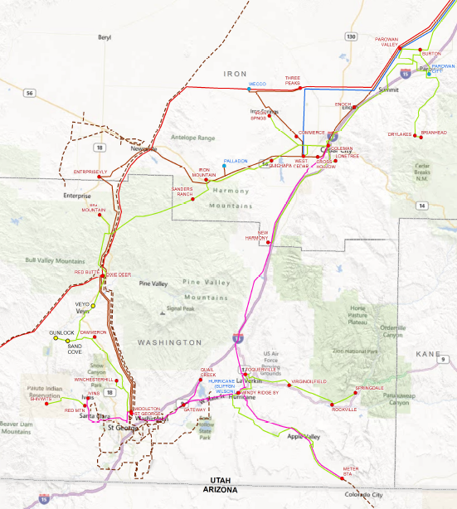
SOUTHWEST UTAH STUDY
PacifiCorp:
Parowan
Cedar City
Springdale
Twin Cities
Ivins
Municipalities/REA:
St. George
Hurricane
Santa Clara
Dixie/Escalante REA
Nathan Wilson/Talmage Daley

Slide 3
Southwest Utah Study
Covers ~ 1,800 square miles of area in Iron and Washington Counties.
There are 6 transmission subs in the area – Parowan Valley, Three Peaks, West Cedar, Red Butte, Middleton and St. George.
Several power entities within study area.
There are 44 substations, 4 being transmission customer substations.
Transmission voltages studied include 69 kV and 138 kV.

Slide 4
Load Growth
Base System Loads
Summer 2013: 564 MW
Winter 2013-2014: 371 MW
Growth
Summer: 2.7%
Winter: 2.7%
Projected System Loads
Summer 2017: 620 MW
Winter 2017-18: 411 MW

Slide 5
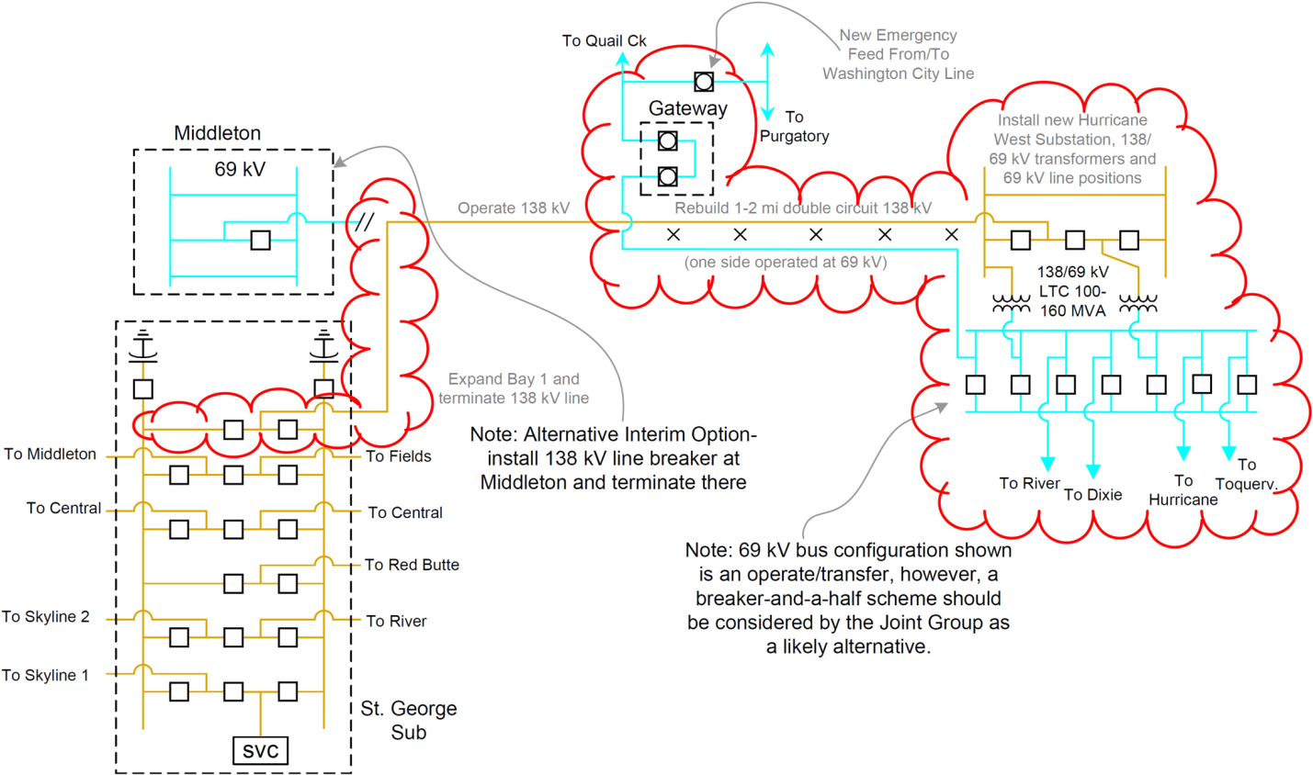
System Improvements
Hurricane West Substation to accommodate new points of delivery.
Designed for future expansion to 345 kV.

Slide 6
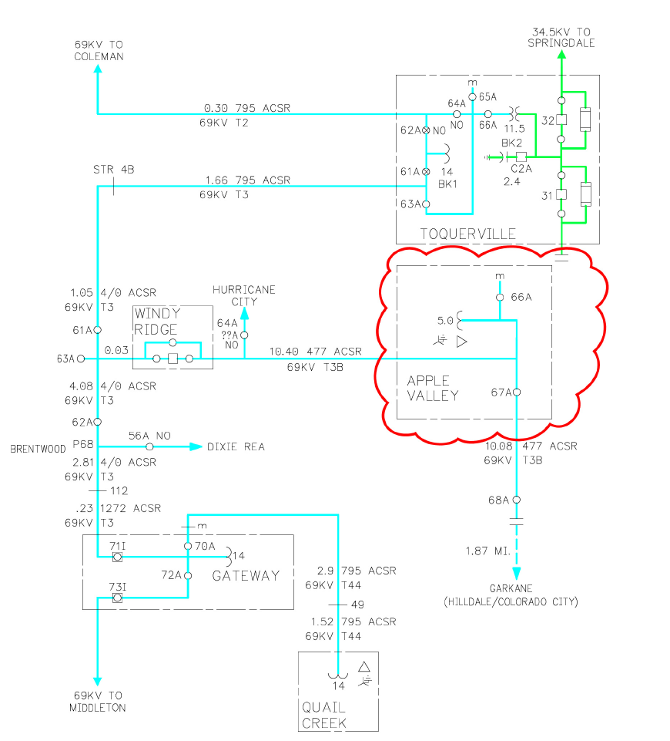
System Improvements
Apple Valley 69-12.47 kV Substation 2015
Required by agreement with Hurricane City.
69 kV source from Middleton via Windy Ridge Substation.
Serves existing 34.5 kV load in Apple Valley.
Total Estimated cost: $4,000,000

Slide 7
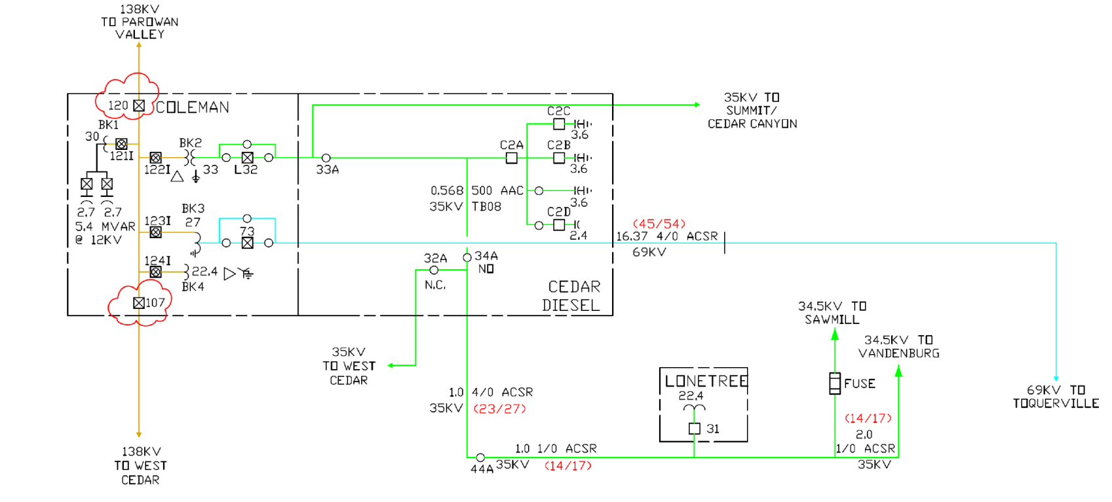
Transmission Reliability Improvements
Coleman Substation Reliability
Circuit breakers on both sources serving 138 kV bus.
Cuts exposure in the Cedar City area by two-thirds.

Slide 8
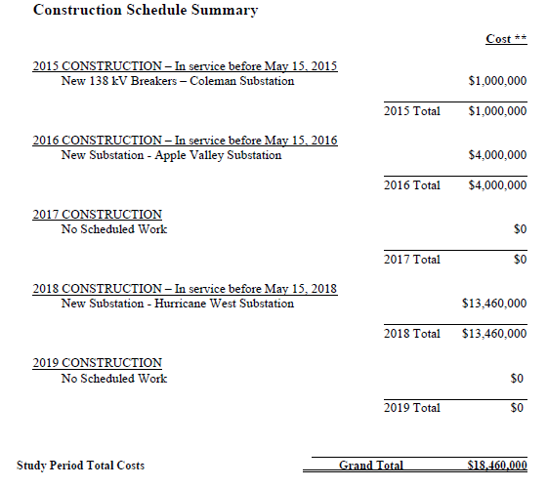
Construction Schedule Summary

