Slide 1
Wyoming WEST Area Study December 2013
Seongtae Kim/Jeremy Viula

Slide 2
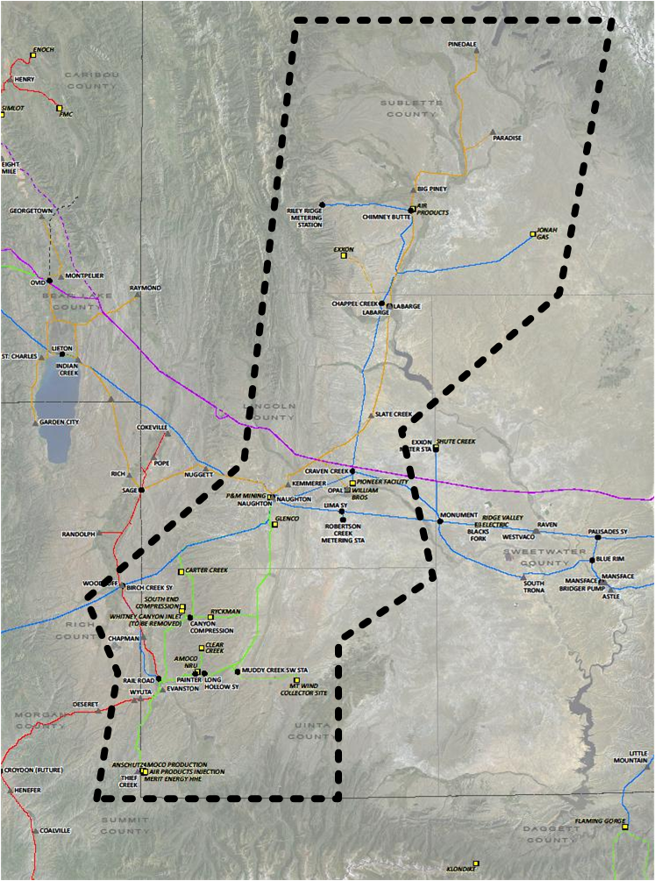
Geographical Location – Wyoming West
Pinedale
Paradise
La Barge
Kemmerer
Naughton power plant
Evanston

Slide 3
General Information – Wyoming West
Area: Total 9,000 square miles (Lincoln, Sublette, & Uinta counties in Wyoming)
Substation
22 PacifiCorp-owned
16 customer-owned
Transmission Voltage
69 kV
138 kV
230 kV

Slide 4
General Information – Wyoming West
Generator
740 MW coal-fired steam plant at Naughton substation
265 MW wind generation in the Evanston area
Load
10 % of residential & commercial
90 % of industrial
Double peaks (Summer & Winter)
77 % overall load factor

Slide 5
Projected Load – Wyoming West
Base System Loads
2012 Summer: 292 MW
2011-12 Winter: 314 MW
Growth
Summer: 3.6 %
Winter: 3.3 %
Projected System Loads
2017 Summer: 415 MW
2016-17 Winter: 436 MW

Slide 6
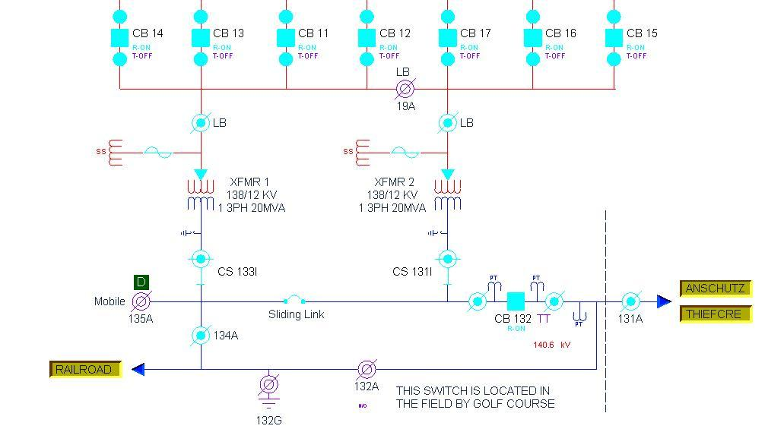
Reliability Issues – Wyoming West
Issues: Overdutied circuit switcher 133A & 131I at Evanston 138 kV substation during 3-phase fault
133A & 131I rating: 7 kA
3-phase fault: 7.31 kA
Recommended solution: Replace both circuit switchers with a higher rating
Estimated cost: $300,000

Slide 7
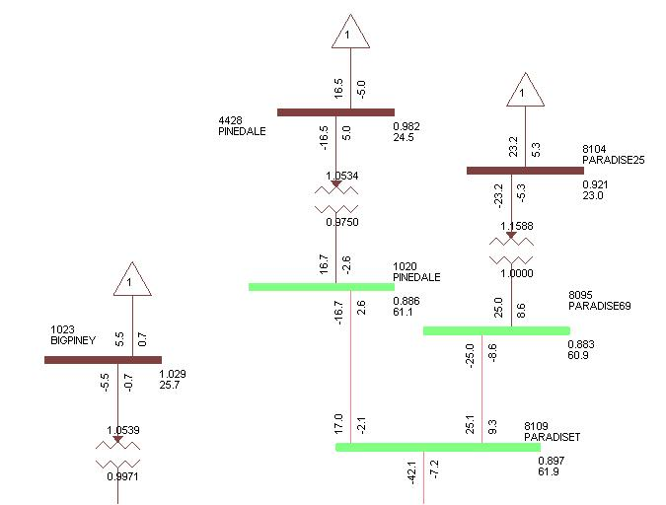
N-0 System Improvements – Wyoming West
Issue: Low voltage
Pinedale 69 kV bus
Paradise 69 kV bus
Paradise Tap 69 kV
First predicted (Assuming full contract utilization): 2013-14 heavy winter
Cause: Impedance of the 69 kV line between Chimney Butte & Paradise Tap (almost 10 % of voltage drop)

Slide 8
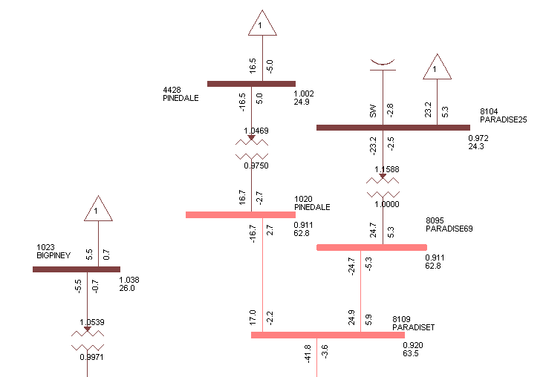
N-0 System Improvements – Wyoming West
Recommended solution: Install 3 MVar switched capacitor at Paradise 25 kV
Advantage of switched capacitor on feeder side over sub-transmission side: less cost & less space
Estimated cost: $195,000

Slide 9
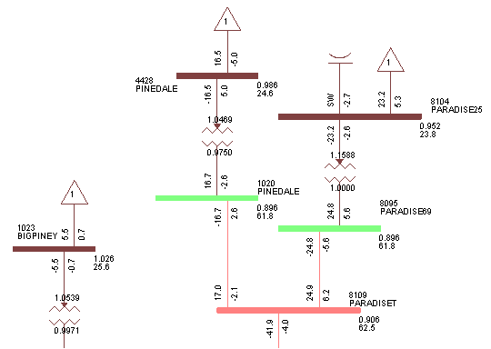
N-1 System Improvements* – Wyoming West
Craven Creek – Monument 230 kV outage
Issue: Low voltage
Pinedale 69 kV bus
Paradise 69 kV bus
First predicted (Assuming full contract utilization): 2013-14 heavy winter

Slide 10
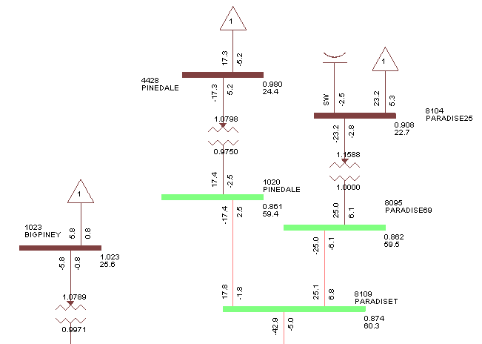
N-1 System Improvements* – Wyoming West
Craven Creek – Naughton 230 kV outage
Issue: Low voltage
Pinedale 69 kV bus
Paradise 69 kV bus
Paradise Tap 69 kV
First predicted (Assuming full contract utilization): 2013 heavy summer

Slide 11
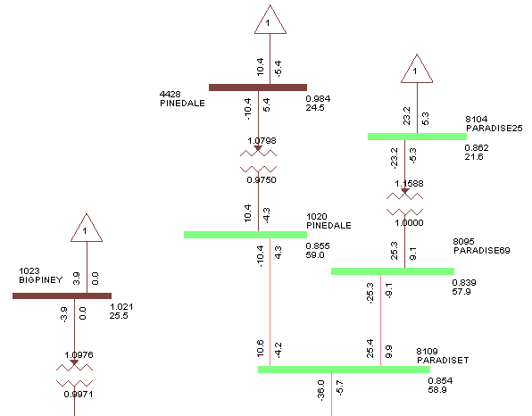
N-1 System Improvements* – Wyoming West
Chimney Butte 230/69 kV 75MVA transformer outage
- replaced by 230/69 kV 50MVA back-up transformer
Issue: Low voltage
Paradise 25 kV bus
Pinedale 69 kV bus
Paradise 69 kV bus
Paradise Tap 69 kV
First predicted (Assuming full contract utilization): 2013 heavy summer
Voltage collapsed below 0.8 pu during 2016-17 heavy winter

Slide 12
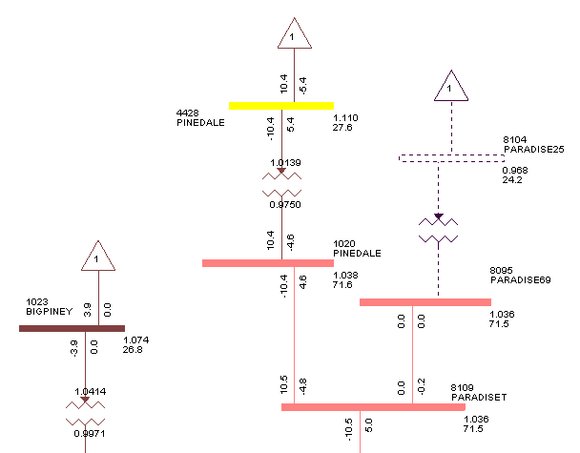
N-1 System Improvements* – Wyoming West
Paradise 69/25 kV transformer outage
Issue: High Voltage
Pinedale 25 kV bus
First predicted (Assuming full contract utilization): 2013 heavy summer
Cause: Instantaneous voltage rise

Slide 13
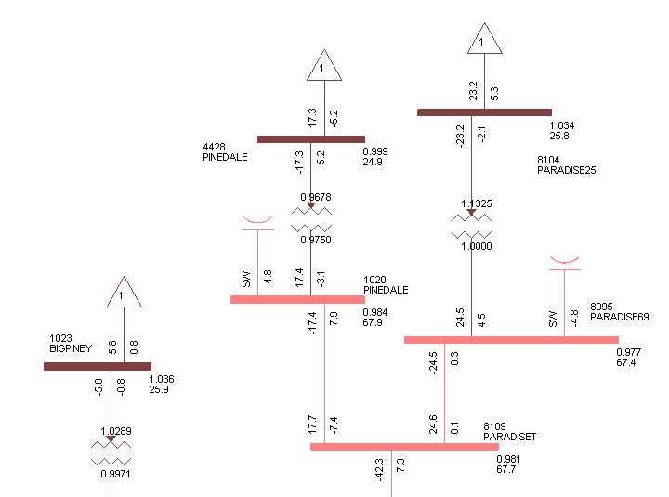
N-1 System Improvements* – Wyoming West
Recommended short-term solution for both high & low voltage issues: Install 2-step (2.5 MVar/step) 5Mvar capacitor bank at
Pinedale 69 kV bus
Paradise 69 kV bus
Estimated cost: $2,367,000

Slide 14
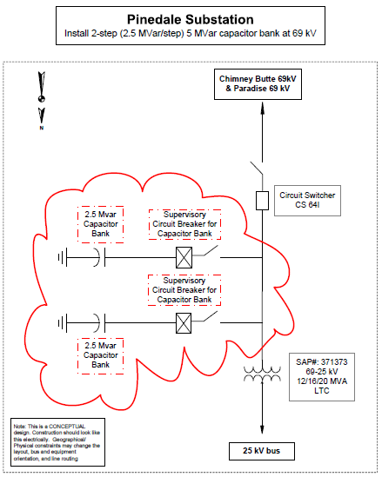
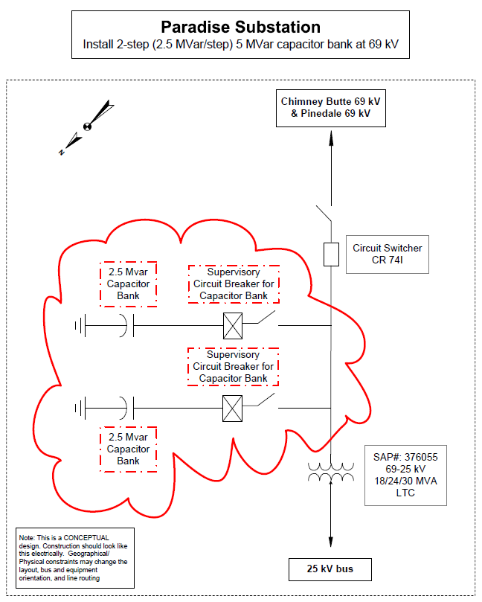
N-1 System Improvements* – Wyoming West
Construction Details
Pinedale 69 kV substation
Paradise 69 kV substation

Slide 15
Construction Schedule – Wyoming West
Total Estimated Cost: $2,862,000

Slide 16
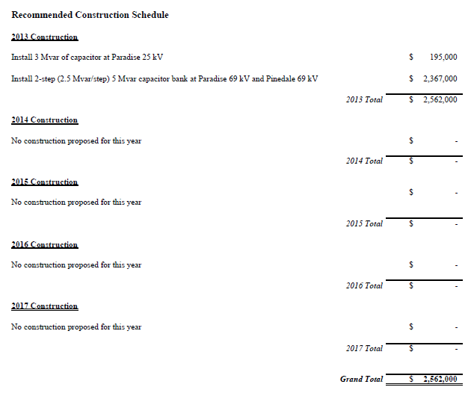
Construction Schedule (cont’d) – Wyoming West
Total Estimated Cost: $2,862,000

Slide 17
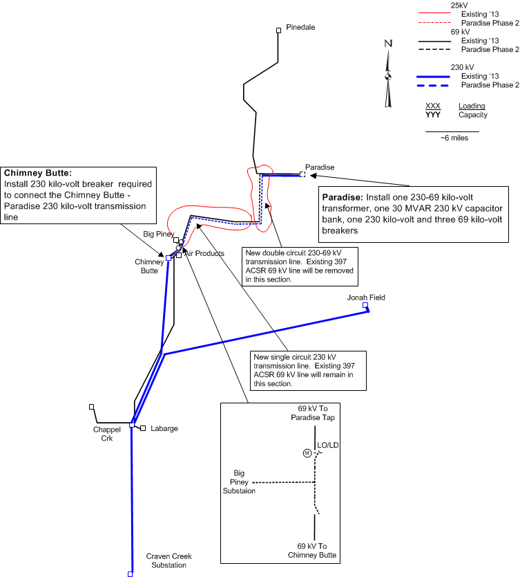
Long-term Solution – Wyoming West
Construction of 230kV line between Chimney Butte & Paradise
Resolved issues
Voltage issues (High & Low) at Upper Green River area
Load serving issue at Paradise
Up to 24.5MVA (Current 69kV line)
27MVA (Contracted load in 2017)
24.1MVA (Anticipated load in 2017)
The project is budgeted & the anticipated in-service date is the end of 2017

Slide 18
Wyoming West Area Study
Any Questions or Comments?

